Slide 1

Business plan of Money Lending in Philippines
01.01.2017

Slide 2
Table of contents
1 | Investment summary | 3-4
2 | Market overview | 5-6
3 | Legal setup | 7-10
4 | Product and Marketing | 11-30
5 | Decision making & Collection | 31-36
6 | IT | 37-40
8 | Finance and Admin | 41-48
9 | Project risks and mitigation | 49-50
10 | Project plan | 51-52

Slide 3
1. Investment summary
Philippines Money Lending Market is one of the most promising in Asia due to a number of factors:
Large population with rising wages, with high portion of young spenders (53% of population under 25).
High smartphone penetration and above-average for the region internet penetration levels.
Majority of formal players (banks, financing companies) focus on products for upper- and middle-class customers, such that a significant portion of population is not penetrated by formal financial services.
Unbanked are currently covered by low-tech and dispersed informal lenders ("loan sharks") and pawnshops.
Money lending regulatory environment is very lenient if compared to the other markets in the region, with no interest caps and no specific advertising and other restrictions. This fact is proven by a set of online moneylending startups already recently launched in the market.
We can achieve outstanding results very fast because of next key success factors:
New convenient product with fixed interest rate, which can replace Loan Sharks’ and Pawnshops’ products.
Using innovative Pure online business model – which will allow customers easily apply for a loan via online and mobile application, receive almost immediate credit decision and get the money in minutes after approval through their bank account or at Payment partner’s offline stores.
New innovative advertising tools will allow us to reduce Marketing acquisition cost to as low as $21.
Philippines lending market is one of the most promising in Asia due huge number of untapped population .
Our main challenge, based on our market research, are lying in Risk area. We will manage this issue by using both innovative big-data scoring models (using external info and web-data), relatively tough verification process and wide usage of different indirect solutions like using secure disbursal channels with obligatory face-to-face identification.

Slide 4
1. Investment summary (cont)
Investments, thsd USD | Year 1 | Year 2 | Year 3 | Year 4 | Year 5 | Total
Portfolio investments | 931 | 600 | 177 | 0 | 0 | 1 709
OPEX and CAPEX investments | 753 | 182 | 0 | 0 | 0 | 935
Total investments | 1 684 | 783 | 177 | 0 | 0 | 2 644
Volume indicators | Year 1 | Year 2 | Year 3 | Year 4 | Year 5 | Total
Number of loans issued, thsd | 30 | 173 | 351 | 520 | 620 | 1 694
Amount disbursed, thsd USD | 2 484 | 14 095 | 28 198 | 41 569 | 49 284 | 135 630
Net portfolio (EoY), thsd USD | 680 | 2 287 | 4 038 | 5 555 | 5 942 | 18 503
P&L, thsd USD | Year 1 | Year 2 | Year 3 | Year 4 | Year 5 | Total
Revenue | 970 | 6 573 | 14 074 | 21 442 | 26 094 | 69 152
Provisions | -604 | -3 003 | -5 517 | -7 373 | -8 793 | -25 291
Variable costs | -358 | -1 264 | -2 319 | -3 372 | -3 947 | -11 261
Marketing acquisition costs | -221 | -608 | -1 112 | -1 577 | -1 775 | -5 293
Salary (variable part) | -93 | -352 | -571 | -812 | -963 | -2 790
Other variable costs | -33 | -155 | -268 | -393 | -466 | -1 316
VAT | -11 | -149 | -368 | -591 | -743 | -1 862
Fixed costs | -830 | -1 012 | -1 070 | -1 288 | -1 383 | -5 582
Salary (fixed part) | -545 | -619 | -617 | -833 | -970 | -3 585
Other G&A expenses | -284 | -393 | -454 | -454 | -412 | -1 998
One-off expenses | -16 | -16 | -16 | -16 | -16 | -79
Net profit before taxes | -838 | 1 278 | 5 152 | 9 393 | 11 955 | 26 939
Terminal value |  |  |  |  |  | 56 916
ROE (annualized) |  |  |  |  |  | 134%
ROAA (yearly) | -123% | 76% | 122% | 147% | 156% | 138%
Break-even period, months | 12
Self-capitalization period, months | 18
Payback period, months | 38

Slide 5
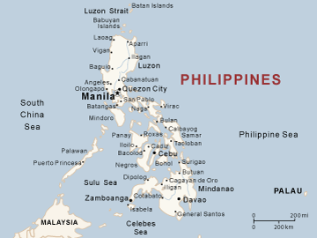
2. General Market Information
Geography: 300 000 sq.km., more then 7000 islands
Population – 102M (2015 est.)*. Urban/Rural population - 30/70%.
Official languages – Filipino, English.
Average monthly income – $250 nationwide (2013)*, in Manila 750*.
GDP Per Capita(Nominal) – $3 000 (2014).
Labors by Industry – 50% of the population work in service, 31% in agriculture, 16% in industry.
Internet penetration – 41%.
Mobile penetration – 103%. Smartphone penetration – 50%.
Bank account penetration – 26.6%.
Online banking penetration – ~4% (2014).
Credit card penetration – 4%.
Debit card penetration – 34%.
Consumer lending reached the level of only 6.6% of GDP ($17,9B).
Our target market size is only about 50M individuals, as almost 30% of the population is a poor people with income less than $120 per month and almost 15% of the population is working overseas.
Data sources: CIA World Facebook, World Bank, Inquirer.net, InternetWorldStats.com, “On Device Research”, McKinsey, & iMoney, Euro Monitor Consumer Loan Lending
http://www.gov.ph/
Notes:
Существуют базовые предпосылки для интенсивного роста проникновения финансовых услуг и увеличения интенсивности пользования ими(в том числе кредитования, кредитных карт и он-лайн сервисов):
1. Экономика Филиппин интенсивно развивается (рост GDP на 7.18% в 2013).
2. В ближайшие годы ожидается значительний рост трудоспособного населения (в бакете от 0-14 лет 33.7% населения;15-24 :19% населения.)
3. Ожидается увеличение темпов роста розничного-кредитного портфеля Филипин на 2 % с 14.4(за 2010-2015 года) до 16.4 (прогноз на 2015 – 2018 года)
4. Низкая база проникновения как офф-лайн финансовых услуг (26.6% проникновение счетов среди трудоспособного населения и 3% кредитных карт) , так и он-лайн (13% проникновение интернет – банкинга)
5. Активный рост проникновения смаротфонов и доступа в интернет - ожидаемый рост за год более чем на X% c текущего уровня x и на X% c текущего уровня x соответсвенно.
** Городские-не городские и города.

Slide 6
2. Consumer finance industry landscape
Consumer lending last years showed considerable growth at the level of 10-15% every year. Banks are actively increasing their network - from 5.5K as of Mar 2014 to 6K as of Mar 2015 (Universal and Commercial Banks).
Rural banks are expanding their businesses in consumer lending, many Filipinos continued to prefer these traditional players due to wide product line and attractive pricing and promotions.
High requirements to the borrowers is a result of low asset quality and low credit bureaus' hit rate.
Number of active licenses*:
638 banks;
598 financial companies;
1637 lending companies.
Major part of Financing and lending companies don't have wide branch network.
POS-lending, Cash loans and Credit card market segments are at early stage of development.
There are only few players (mostly established in recent 2 years) operating via Pure online business model.
Most part of MFIs offer long-term loans as an alternative to banks' loans.
We see a niche in the market covered neither by banks (which are focused mostly on middle and above segments), nor by the Financing/Lending companies. We have opportunity to get this market niche with our innovative Pure online business model and “classic” PDL product meaning absence of significant modifications.
Data sources: Report “Family Income Distribution in the Philippines from 1985 to 2009″ published by Social Weather Stations (SWS)
**** http://www.bsp.gov.ph/banking/pbs_new/1.1.htm ;;http://www.sec.gov.ph/investorinfo/registeredentity/lending/2014Dec31_List_of_Lending_Cos.pdf; http://www.sec.gov.ph/investorinfo/registeredentity/financing/financin%20companies%20063009.pdf ; http://www.bsp.gov.ph/banking/pbs_new/1.1.htm

Slide 7
3. Licensing options
# | Parameter | Bank | Financing company | Lending company | Cooperative | PawnShop
1 | Main purpose | Full-range banking activity for retail and corporate banking | Limited licence allowed to conduct consumer finance, allowed to borrow funds from more than 19 investors | Granting loans from its own capital funds (capital could be borrowed not more than 19 individuals) | Credit operations that are owned and operated by its members. Loans granted from owners funds. | Credit operations with pledge
3 | Regulation | Banco Central | Security Exchange Commission | Security Exchange Commission | Security Exchange Commission | Banco Central
2 | Minimum paid-in capitalization | $54 000K | $225K | $22K | $56K | $2K
3 | Max foreign capital share | 40% | 60% | 49% | - | 30%
4 | Possibility to sell retail credit products | Yes , all the products | Yes, all the products | Yes, all the products | Yes, except credit cards | Yes, secured
5 | Possibility to collect retail deposits from individuals | Yes | Yes, on condition of receiving additional BSP* approval | Not allowed | Not allowed | Not Allowed
6 | Number of licences*** | 638 | 598 | 1 637 | n/a | 6 279
Among the available official licensing options Financing company (FC) is the best option, as it will allow us to be the main shareholder with 60% share and also gives us possibility to collect retail deposits to cover funding. Furthermore SEC regulation is much less strict then Banco Central’s.
* BSP – Bangko Sentral ng Pilipinas, local Central Bank.
** Depends on the business model, PDL and Installment loans can be implemented.
*** http://www.bsp.gov.ph/banking/pbs_new/1.1.htm ;;http://www.sec.gov.ph/investorinfo/registeredentity/lending/2014Dec31_List_of_Lending_Cos.pdf; http://www.sec.gov.ph/investorinfo/registeredentity/financing/financin%20companies%20063009.pdf ; http://www.bsp.gov.ph/banking/pbs_new/1.1.htm

Slide 8
3. PH Financing company legal setup
equity participation
SG
Obligation
«XXXXXX Co in SG»
Pre-paid capital
Call-option agreement
PH
Blank share transfer forms
$89K
Nominee services agreement
Consulting agreement
60%
$133K
Country Manager
Nominee
Shareholder
@Money Lender@ Financing company
Directors structure:
2 – represent «XXXXXX Co in SG»
2 – Independent
1 – represents local
40%
Only Country Manager has access to the bank account
Legal defense
Nominee Shareholder:
Call-Option agreement with «XXXXXX Co in SG» or its designated person is the purchaser
By -Laws: The majority of commercial decisions should be approved by «XXXXXX Co in SG», the rest require 2/3 of votes as per local laws
Blank share transfer forms
Nominee Directors:
By-Laws (important commercial decisions (reserved matters) are to be approved by «XXXXXX Co in SG»)
Nominee services agreement (1 «XXXXXX Co in SG» copy): all Directors’ decisions should be approved by «XXXXXX Co in SG»
Consulting services agreement with Directors on their communication with the regulator on behalf of Doctor Cash

Slide 9
3. Key regulatory points
# | Sphere of regulation | The essence
1 | New licenses issuance by regulator | Ongoing, no restrictions.
2 | Allowed credit products | Instalment loans (including PDL), Revolving credit line, mortgage, credit cards (issued and processed by the bank).
3 | APR/EIR interest cap | No
4 | Advertising requirements | No specific restrictions, just basic requirements (the percentage that the finance bears to the total amount to be financed expressed as a simple annual rate on the outstanding unpaid balance of the obligation).
5 | Necessity to obtain written customer’s consent for processing his personal data | Not mandatory (can be done on a website or mobile application).
6 | Face-to-face customer’s verification (KYC procedure) | Mandatory, but may be outsourced by the third-party who will conduct face-to-face identification and ID check.
7 | Remote contract signing | Online contract signing is possible (loan application can be signed by the customer’s digital signature, issued to the customer in the form of 6 digit number and delivered via SMS, then we’ll accept this offer by granting a loan).
8 | Debt collection | No specific restrictions.
Philippines market can be characterized as one if the most suitable for using “Pure online” business model, which is fully feasible here. The only thing which needs attention is meeting requirements of conducting KYC procedure – which is mandatory, but could be done by the third party (our Payment partner).
* Since 7 January 2000
** CODE OF BANKING PRACTICE

Slide 10
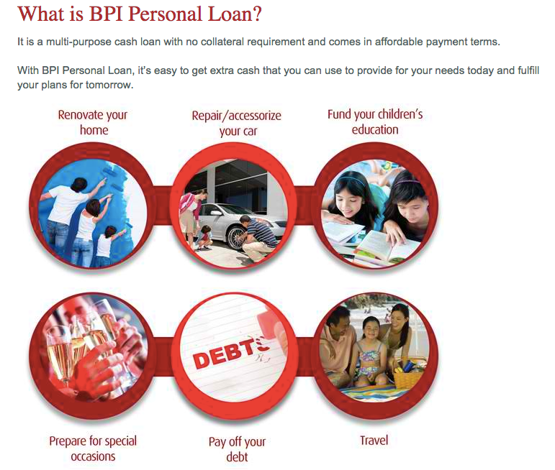
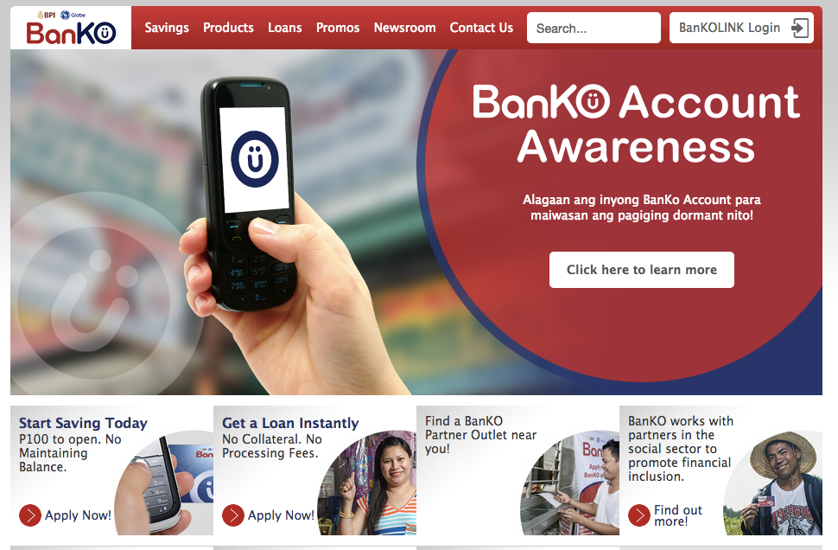
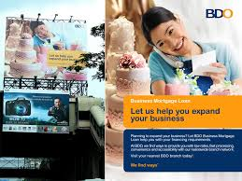
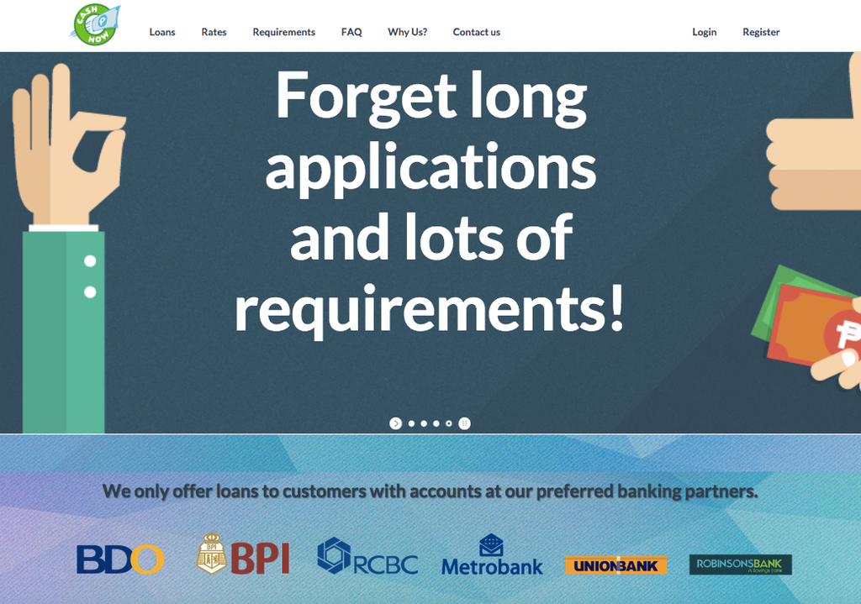
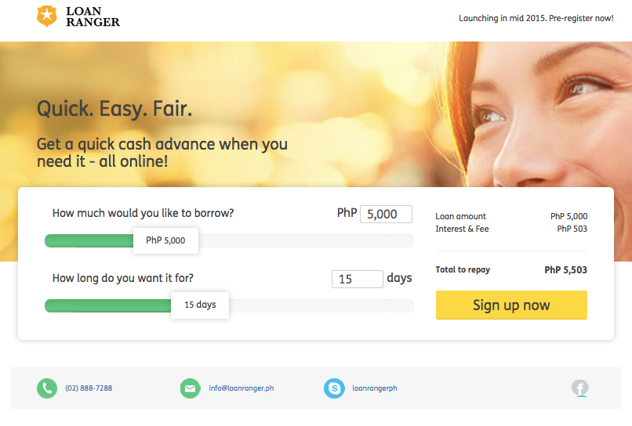
3. Marketing regulation
Limitations
We’ve encountered few legal/regulatory limitations on the marketing of personal loans in the Philippines. We seem to have a “free hand” in this market in terms of the marketing/advertising channels and content that we will use to promote the payday loan product. The only restrictions are: Mandatory necessity to inform customer about all the loan parameters To care about privacy of personal data
Market practice
As a result of the lack of limitations restricting the advertisement of lending products in the Philippines we see analogous business models employing all manner of methods to attract borrowers and no apparent restrictions on the verbiage used to solicit.
* Regulation Consumer Act; Article 114. Advertising of Open-end Credit Plan; Cybercrime Prevention Act of 2012

Slide 11
4. Market landscape
Type | Description | Product parameters | Comments
Banks | Three banks are dominating the market with 60% share. Owned by large conglomerates, these banks are avoiding aggressive pricing competition and focusing on the following spheres: - Bank of the Philippine Islands (BPI) – mortgage. - Metropolitan Bank & Trust (Metrobank) – car loans. - Banco de Oro (BDO) - credit cards. | 12-30% per annum interest rate. $4K-45K average loan amount. 6-60 months loan tenor. Strict requirements for borrowers - working in TOP25K companies, necessity to present 2 IDs. Average time-to-decision is 2-5 days. | Banking market faced with crisis in 2008, after their operations become very conservative in terms of loan granting. As a result just a small number of people have access to banking services. 7 retail banks are going to launch operations in Philippines till the end of 2016.
Financing/ Lending company (FLC) | TOP10 FLCs holds 60% of all portfolio 1st Valley Bank they are:1st Valley Bank , CARD NGO , ASA Philippines, TSPI, ASKI, Valiant RB, BangkoKabayan, PBC. | 40-120% per annum interest rate. $100-4K loan amount. 12-24 months loan tenor. Strict requirements for borrowers –necessity to present 2 IDs, home bills, proof of salary. Average time-to-decision is 1-5 days. | Microfinance industry is very close to the banking one in terms of products and requirements to borrowers. Their main strategy is to be close to customers in provinces.
PawnShops | Pawnshops are widely presented in the country. The biggest players are M. Lhuillier, Cebuana Lhuillier, Tambunting Pawnshop, Palawan Pawnshop. They cover major part of the total number of 17,000 pawnshop branches. | 36% per annum interest rate. $100-4K loan amount. Collateral is a mandatory requirement. | Unlikely to the markets - PawnShops always had low interest rate and was a trusted quick loan source.
LoanSharks | Mostly Indians with “5/6” model – meaning receiving 5, paying back 6 and usually conducting without any licenses (Loan sharks market volume close to official market volume). | 20% per month interest rate. Less than $100 loan amount 1 month/week loan tenor. Customers’ bankcards are often used as a collateral. | Usually work in residential areas, Alternative loan providers for unbanked population or clients with unofficial job. Loanshark services are very popular in Philippines.

Slide 12
4. Consumer Finance Industry Landscape
Average Annual Income Segments
Current Market Coverage
SEG A
Banks
Pawnshop
Lending
company
Income Segment
Loan Sharks
Our Market Niche
SEG E
Off-Line
Online**
Level of Digitalization
We are going to operate mostly in Segment D – with customers having average monthly income of ~$360.
Among our main competitors we see Loan Sharks and FLCs.
Our main competitive advantage – really quick decisioning and possibility for the customer to obtain the money by just applying online.
We also will be more convenient then Loan Shark due to transparent product parameters.
Data sources: Report “Family Income Distribution in the Philippines from 1985 to 2009″ published by Social Weather Stations (SWS)
* Share in # of families
Notes:
При низком показателе проникновения кредитных продуктов, основная их часть сосредоточена в сегменте SEC A и SEC B, при высоких требованиях к заемщику. Стратегия DCFC – всегда доступная финансовая поддержка рядом с клиентом посзволяет ориентироваться на 70% рынка.

Slide 13
4. Market Size Estimation
Official PDL Market is relatively small if compared with the black market.
25% of population is using LoanSharks’ services*.
Yearly market size growth* – is estimated at the level of 7% in 2015-2017.
Our market share as of 2020 is expected to be at the level of 2.4%.
Parameter | EOY2016 | EOY2017 | EOY2018 | EOY2019 | EOY2020
Our sales volumes, $M | 6,5 | 23,8 | 46,5 | 67,6 | 77,9
#loans sold, thsd. | 42 | 144 | 273 | 389 | 441
* Euro Monitor Consumer Loan Lending

Slide 14
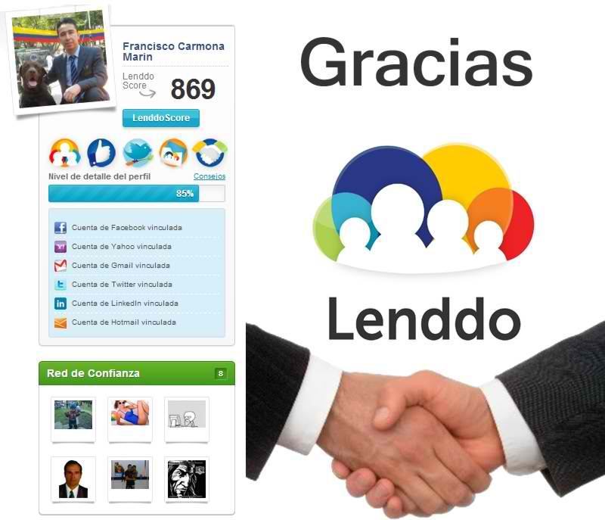
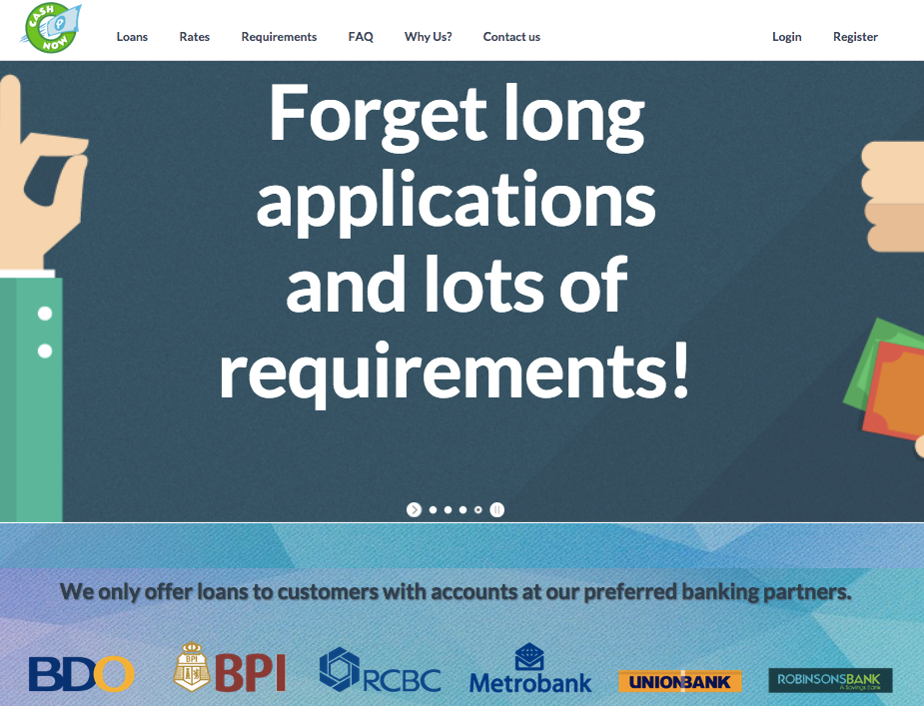




4. Our main online competitors
Type | Competitor | Currently opperating | History | Business model | Sales volumes | Summary
Online | Lenddo | No | Launched in 2012 | Uses pure online model. Application process is complicated due to long authorization process. | 500 loans per month. | Widely known in the market and even abroad. Recently has stopped operations due to high credit losses. Owned by founders and venture investors
 |  | No | Launched in in 2014 by Lending Corporation | Operates fully online with documents uploading. | n/a | Our mystery shopping showed that they currently don’t operate.
 | MobileBank | No | Est.by American investors and plan to launch sales in 2015 | Plan to become a P2P platform under FC licence. | Not operating yet | Plan to cover small business.
Mobile | BanKO | Yes | Launched by Telecom Globe and Bank BPI in 2014 | Applying for a loan via mobile phone. In order to get the money customer needs to visit a branch to open a mobile money account. | $500k credit portfolio | Mystery shopping showed that that applying process is very tough (so we could not even find an office to open an account).
 | Mbank | No | Launched in 2013 by Telecom Smart | Mobile advertising. Plan to deliver money and contract to customers by DSA | Does not operate currently | Plan to be the BanKO competitors.
O2O | PawnHero | Yes | Newly launched by 2GO investments | Online advertising, offline collateral collection and 2GO card delivery. | 3000 loans per month | Average interest rate is 1,5% per month (twice lower then in offline pawnshops).

Slide 15

4. Lenddo case study
General description – established in 2012, one of the most widely known pioneers among the moneylenders who is using Pure online business model. Stopped sales 1 year ago.
Product – short-term cash loan with amount from 2,5K to 15K PHP ($55-332) and term up to 1 month. Interest Rate – 1% per day.
Advertising – context advertising (Google AdWords through Finch).
Application process –– Login in Lenddo with Facebook (FB) account after filling in application
Business process description:
From applying to obtaining credit decision – 1 hour.
From approval to loan disbursement – from online to up to 24 hours.
Money transfer speed – 1 working day.
Main achievements:
Granted 11K loans during 2 years
Developed IT platform for customers verification and scoring in Facebook with hit rate more then 70%
2 rounds of investments attracted
Market players’ opinion about Lenddo:
“Lenndo was no profitable due to high risks”.
“There were lots of requests to Lenddo from potential borrowers, but due to tough and complicated process conversion rate was very low, while delinquency was high”.
Paying too much attention to FB as a key source of information about the customer was obviously insufficient to manage credit risks properly”.
The company didn’t succeed in micro-lending due to complicated applying process and lack of risk management skills&experience, which lad to high credit losses. At the same time “Lenddo” have proved feasibility of the Pure online business model in Microlending.
15

Slide 16
4. BanKO case study
General description – established in 2014, under partnership of BPI and Globe. Currently is at the pilot stage, checking feasibility of the mobile bank (based on cash mobile wallet, providing savings, payment and remittance service, selling ) with mobile wallet business model for BanKO customers Its necessary once to provide ID to BanKO partner’s office. Survey showed that its very difficult to find office to open an account.
Products:
Installment loan: interest rate 56% per annum, max amount $55, term up to 90 days.
Salary loan for accredited corporations (Payroll with BPI) employees: interest rate 24% per annum
Commercial Loans: interest rate 30% per annum
Advertising – mostly via Globe menu and SMS, low activity in web.
Application process – BanKO require to open accounts for customers, that’s why process is rather complicated. After application customer has to login with FB and make 7 steps via mobile phone, after approval he has to provide ID to partners.
Business process description :
From applying to obtaining credit decision – 1 hour.
From approval to disbursal – from online to up to 24 hours.
Money transfer speed – 1 hour after signing.
Main achievements:
Credit portfolio has reached ~$500K.
Number of the customers exceeded 1 000 000.
Market players’ opinion about BanKO:
“BanKo currently is in the pilot stage with low portfolio, but they have big plans to increase sales”.
“BanKO is currently at the stage of the pilot with low number of clients”.
BanKO business model showed us complicated applying procedure and relatively small sales volumes. So it’s to early to make any conclusions or outcomes. We will continue monitoring their development.
16

Slide 17
4. CashNow.ph case study
General description – established in 2014, Our mystery shopping reviles that they are not currently operate.
Product – short-term cash loan with amount from 2,5K to 15K PHP ($55-332) and term from 3 to 6 month. Interest Rate – 10% per month.
Advertising – context advertising (Google AdWords through the Fitch)
Application process – Online application with requirements to upload proof of billing and proof of salary, if customer pre-approved - Skype interview follows.
Business process description :
Applying to obtaining credit decision – online.
Approval to disbursal – Indeterminate.
Money transfer – 1 day.
Market experts’ opinion about the Company:
Head of CashNow – We are going lo launch business in 2016.
CashNow.ph are going to launch in 2016year, currently test advertising.
17

Slide 18
4. PawnHero.ph case study
General description – established in 2015, Funded by 2GO Delivery
Product – secured loan with amount based on ledger (average loan $300). With low interest rate - 1.5% per month.
Advertising – context advertising (Google AdWords)
Application process – Online application with requirements to upload photo of item. 2GO couriers deliver pre-paid card and pick up item
Business process description :
Applying to obtaining credit decision – online .
Approval to disbursal – Indeterminate.
Money transfer – 2 days.
Main achievements:
20% Growth each month (based on CEO words)
More then 3000 loans granted per month (based on CEO words)
Market experts’ opinion about the Company:
Head of PawnHero – “We have 20% growth each month with number of loans more then 3000 per month”.
PawnHero.ph –first online pawnshop in Philippines with good performance, they are going to expand operations to another Asian countries.
18

Slide 19
4. Competitors product parameters
# | Competitor | Interest rate | LA | LT | Time-to-Money | Loan disbursement channel | Comments
1 | Loan shark | 240-480% per annum | $50-200 | 1 month (with weekly payments) | 1 day | In cash during face-to-face meeting | Unsecured
2 | Pawnshop | 36-48% per annum | $100-3000 | 1-12 months | 1 hour - 1 day | At branch | Collateralized loans
3 | FLCs* | 33-240% per annum + Up-front fee 0-5% of LA | $56-2K | 5 days – 18 months | 2 hours – 20 days | Transfer at bank account/Mobile wallet or at branch | Loans can be unsecured and Secured, with or without coborrower
4 | Cooperative | 30-410% per annum | $89-17K | 4-6 months | 2 hours – 20 days | In office | Unsecured/Branch
5 | Bank Credit Card | 42% interest rate per annum + fee $27 service fee per year | $50-5000 | Not limited | 3-7 days | At branch | Unsecured/ Branches, online application
6 | Bank Cash loan | 17-40% per annum | $3K-45K | 6-60 months | 3-5 days | Cash/Check/ Online | The customer has to come to the branch anyway. Also the customer has to be officially employed.
Our main competitors are Loan sharks and FLCs as there are no operating online PDL players on market at the moment (Lenndo, cashnow.ph stopped their operations due to high risk).
Data sources: imoney.ph/credit-card, mftransparency.org/microfinance-pricing/philippines/, mftransparency.org/microfinance-pricing/philippines/001-1st_Valley_Bank/, mixmarket.org/mfi/country/Philippines
* Companies works under Financing, Lending or Cooperative license with main target to reach unbanked population via unsecured loans

Slide 20
4. Closest competitors product parameters
# | Parameter | Existing unsecured loan products from lending companies and finance companies | Loan Sharks
1 | Loan amount range | $50-2K | $50-200
2 | Loan tenor range | 5 days- 18 month | 1 month (fixed)
3 | Upfront admin fees | 0-5% of the LA | 0
4 | Interest rate per year | 33%-240% per annum | 240%-480% per annum
5 | Late interest rate | 1% per day | -
6 | Prolongation service | No | No
7 | Time-to-money | 2 hours- 20 days | 1 day
8 | Loan disbursal | At branch (in cash) | At customer’s home (in cash)
9 | Minimum requirements | 2 IDs, proof of income, pay slip, character from church or home owners association | -
10 | Application form | Offline | Offline
We are planning to poach customers from Loan Sharks and Lending companies with unsecured products due to our advantages: simple and transparent product, simpler requirements in terms of the documents to present, instant credit decisioning, online credit contract signing, convenient loan disbursement channels.

Slide 21
4. Our Product Parameters
# | Parameter | Value
1 | Product type | Revolving credit line
2 | Credit limit range, $ equivalent in local currency | 2 000 PHP – 23 000 PHP ($44-500)
3 | Initial payment period length, calendar days | 7-30 (depending on customer’s request)
4 | Standard payment period length, calendar days | 30
5 | Interest rate, % per day | 1%
6 | Overdue interest rate, % per day | 2%
7 | Late payment fee (one-time ) | 920 PHP ($20)
8 | Disbursement fee (one-time fee charged in the beginning of the initial payment period), % of the loan amount | 0
9 | Credit line prolongation fee % of the principal | 9%
We plan to start with credit line, using completely standard product parameters. In addition to that we also plan to test Loyalty program of gradually decreasing interest rate for the every repeat loan taken and successfully repaid by the existing customer.

Slide 22









4. Initial sales business process (Phase 1)
SM scoring provider
Terrasoft
Applying
Decisioning
Contract signing
Loan granting
1.Filling app with DSAs
4.Visual stop factors check
15.Paper contract signing
16.Uploading documents’ scans in CRM
2.Filling app during the call to/from Call center
5.Stop factors check
9.Soc.-dem. scoring
11.Request to local risk resources/partners
14.Phone verification (3)
17.Documetns scans’ (data) checking
20.Loan granting
21. Money transfer to existing bank account or moneyshop
6.Black lists check
8.Anti-fraud web-scoring
12.Request to credit bureau
13.Credit rules
18.Explicit customer’s confirmation
19.Contract making
Customer
Web site
Functionality already available in Terrasoft and planned to be used
3.Filling online app on website
7.Online general stop factors check
10.Online mobile phone verification
Functionality already available in Terrasoft but not planned to be used
New functionality to be implemented in Terrasoft
SMSs
Already implemented integrations
SMS-agent
Credit bureau
GL
New integrations to be implemented in Terrasoft
In the very beginning we plan to use only 1 (Website) out of 3 (DSA, Call center, Website) already implemented channels of customers acquisition. Meaning that we won’t use #1, 2, 4, 15, 16 functionality blocks. As for the new functionality – we plan to develop new risk procedures (#8, 11) and make 6 integrations of Terrasoft with other systems and partners.

Slide 23


4. Repeat sales business process (Phase 1)
Terrasoft
Applying
Decisioning
Loan granting
1.Request during the call to/from Call center
3.Black lists check
5.Soc.-dem. scoring
7.Request to credit bureau
8.Credit rules
9.Explicit customer’s confirmation
10.Loan granting
11. Money transfer to existing bank account or moneyshop
Web site
2.Filling online app on website
4.Online general stop factors check
6.Online mobile phone verification
Customer
Functionality already available in Terrasoft and planned to be used
SMSs
SMS-agent
Credit bureau
GL
Functionality already available in Terrasoft but not planned to be used
New functionality to be implemented in Terrasoft
Already implemented integrations
New integrations to be implemented in Terrasoft
In the very beginning we plan to use all 2 (Call center, Website application) already implemented channels of repeat customers acquisition. No new functionality is needed for the start of repeat sales.

Slide 24




4. Target initial sales business process (Phase 2)
Web scoring provider
Telecom data scoring provider
18. SM scoring
Terrasoft
Applying
Decisioning
Contract signing
Loan granting
1.Filling app with partners
5.Visual stop factors check
19.Paper contract signing
20.Uploading documents’ scans in CRM
2.Filling app during the call to/from Call center
6.Stop factors check
11.Soc.-dem. scoring
14.Request to local risk resources/partners
17.Phone verification (3)
21.Documetns scans’ (data) checking
24.Loan granting
25. Money transfer to existing bank account or moneyshop
7.Black lists check
10.Anti-fraud web-scoring
15.Request to credit bureau
16.Credit rules
22.Explicit customer’s confirmation
23.Contract making
Customer
Web site
Functionality already available in Terrasoft and planned to be used
3.Filling online app on website
8.Online general stop factors check
12.Online mobile phone verification
Functionality already available in Terrasoft but not planned to be used
Mobile App
New functionality to be implemented in Terrasoft
4.Filling online app in the App
9.Online general stop factors check
13.Online mobile phone verification
SMSs
Already implemented integrations
New integrations to be implemented in Terrasoft
SMS-agent
Credit bureau
GL
On the next phase we plan to implement inhouse SM scoring procedure (#12), make 3 new integrations of Terrasoft with partners.

Slide 25
4. Target repeat sales business process (Phase 2)
Terrasoft
Applying
Decisioning
Loan granting
1.Request during the call to/from Call center
4.Black lists check
7.Soc.-dem. scoring
10.Request to credit bureau
11.Credit rules
12.Explicit customer’s confirmation
13.Loan granting
14. Money transfer to existing bank account or moneyshop
Web site
2.Filling online app on website
5.Online general stop factors check
8.Online mobile phone verification
Customer
Mobile App
3.Filling online app in the App
6.Online general stop factors check
9.Online mobile phone verification
SMSs
Functionality already available in Terrasoft and planned to be used
Functionality already available in Terrasoft but not planned to be used
SMSs
SMS-agent
Credit bureau
GL
New functionality to be implemented in Terrasoft
Already implemented integrations
New integrations to be implemented in Terrasoft
On the Phase 2 we plan to implement Mobile App(s) to provide customers convenient tool for “push-button” instant repeat sales and self-services.

Slide 26



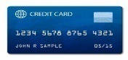
4. Marketing Strategy of competitors
Competitors strategy:
Our advantages:
Simple and transparent product parameters.
Minimum documents required.
Instant credit decisioning.
Wide range of ways how to apply (online and offline).
Various channels to receive and repay the loan (different channels provided by our Payment partner).
High
Loan Sharks
Banks
Segment
Online share
Demands
Tools
Pawn Shops
Credit Cards
Cash Unsecured Loan
(Loan Shark)
Permanent small loan needs
Stickers, Recommendations
Secured Loan (Pawn Shops)
Free Market Niche
Cash Loan Small Amount
(Banks/FC)
Average loan with
no access to bank
Billboards, Leaflets
convenient to borrow*
Cash Loan Middle Amount
(Banks/FC)
Large average loan amount
Billboards, Leaflets, offices, online
Credit Card
(Banks)
Low
Infrequent Liquidity -gap
Online advertising, off-line shops, leaflets
OffLine
Online**
Sales Channel
Most part of the market players, unlikely to us, are using old Offline business model. We will use advanced advertising technology and Pure online business process to defeat low-tech offline competitors.
*Requirements to provide documents and proof of bills etc
** Based on model of sales(Sales Channel)
Notes:
При низком показателе проникновения кредитных продуктов, основная их часть сосредоточена в сегменте SEC A и SEC B, при высоких требованиях к заемщику. Стратегия DCFC – всегда доступная финансовая поддержка рядом с клиентом посзволяет ориентироваться на 70% рынка.

Slide 27
4. Doctor Cash Advertising Strategy
# | Channel | Basing | Advertising Model | Potential Partner | MCA*
1 | Online Advertising | Have experience with one PDL online lender at Philippines | Google AdWords, SEO, Banners, FB | “Finch” | $20**
2 | Partners | Few number of pos-loans players | Off-line in points of sales | Agents | $21
3 | Mobile app and FB App | Fast growth of smartphone penetration with more then 90% Facebook Penetration | Mobile advertising and Facebook advertising | FB + “Globe” | N/A
4 | Outbound Calls | Base of borrowers | Outbound calls to existing borrowers | Telemarketing | $22
5 | SMS | We can targeting to competitor DB |  | “Smart telecom? | $21
6 | ATL | To supports sales volume | ATL with target to switch to remote channels | Advertising agency | N/A
Some facts about the local market:
The market is at a relatively early stage of development – meaning that there is no “overpricing”.
Currently there is no any Online lender in the market – so this niche is empty.
Philippines is among the countries were FB is providing totally FREE internet access to FB to all the mobile internet users – that boosted FB penetration and simplifies us resolving “coverage” issue.
Our marketing strategy for the first year is to start with “standard” online advertising tools and “test, test and test” to identify and immediately scale up using the most efficient ones. Also we plan to “market” Mobile App in order to enter the market when it will be ready for that. Another idea is to test partnership with retail partners and full-scale ATL campaigns to be able to get targeted volumes. We expect average MAC to be at the level of no more than $21.
*Marketing acquisition cost – acquiring 1 customer.
**Based on “Lenddo” experience (MAC=$20).
Notes:
При низком показателе проникновения кредитных продуктов, основная их часть сосредоточена в сегменте SEC A и SEC B, при высоких требованиях к заемщику. Стратегия DCFC – всегда доступная финансовая поддержка рядом с клиентом посзволяет ориентироваться на 70% рынка.

Slide 28
4. Sales Plan
Short term monthly sales plan:
 | Month 1 | Month 2 | Month 3 | Month 4 | Month 5 | Month 6
Number of loans to new clients disbursed per month | 300 | 600 | 900 | 1200 | 1500 | 1800
Long term monthly sales plan:
Parameter | EOY 0 | EOY 1 | EOY 2 | EOY 3 | EOY 4 | EOY 5
Number of loans to new clients disbursed per month | 300 | 4000 | 9200 | 15000 | 18500 | 18500
Share of channels for new customers
Online advertising | 100% | 90% | 73% | 67% | 60% | 60%
Partnership | 0% | 4% | 13% | 17% | 20% | 20%
OutBound telemarketing | 0% | 3% | 7% | 8% | 10% | 10%
SMS | 0% | 2% | 7% | 8% | 10% | 10%

Slide 29



4. Payment partners comparison
# | Partner | Network | Disbursement tariff | Money delivery time | Comments
1 |  | 5000+ cash-out branches: 15 banks + 2 non-bank partners | Average fee: Banks accounts – 15 PHP (~$0,3) Offline pick up – 15 PHP (~$0,3) Existing Card- 15 PHP ($0,3) Door-to-Door 100 PHP ($2,3) | 1. Big banks – online. 2. Medium and small banks – 0,5-6h. 3. Lhuillier – 0,5-4h. | Wide network for payment Previously worked for loan disbursement. Better integrations with banks and Lhuillier
2 | Coins.ph | 5000+ cash-out branches: 15 banks + 5 non-bank partners | Average fee: Banks accounts – 15 PHP (~$0,3) Offline pick up – 80 PHP (~$1.7) Existing Card- 15 PHP ($0,3) Door-to-Door 120 PHP ($2,6) | 1. Big banks – online. 2. Medium and small banks – 0,5-6h. 3. Lhuillier – 0,5-4h. | Wide network for payment 7/11 Integration
3 | Ayannah | 7000 outlets | Could be discussed after registration FC | Don’t have KYC covered outlets for cash-out | Medium network for payment
Coins.ph and DragonPay will allow us to get more than 5K (the highest number between competitors) branches for disbursement and repayment, all with one API. During portfolio development we are going to integrate directly with payment agents.
* Turn-around-time.
** For all partners Banking account transfer takes less then 24 hours, PawnShop the same day
All partners – technical platforms, not necessary to have license

Slide 30
5. Risk management summary
Main risks lay in fraud and lack of credit bureau data areas. We plan to mitigate them using the following:
Taking into consideration best local practices and our current experience in risk management will help us to get competitive advantage. We plan to obtain low default rate of less than 14% (after the first year) due to using the following risk mitigation tools:
# | Area | Factor
1 | Fraud | There is no ultimate official identification document in Philippines and its easy to buy almost any fake document with the price as low as $10 per document.
2 | Low ability to manage risk | Currently there are 4 credit bureaus in Philippines but number of records are small (Central Credit Bureau will be launched in Q4 2015)
3 | Market players practice | Loan Sharks (mostly Indians) operate in residential areas and manage risk using small frequent payments (daily/weekly) and by direct contact with borrower’s relatives at his place of living. Most part FLCs use high requirements for the borrowers - necessity to present 2 IDs, a Proof of employment, a Proof of bills.
# | Tool
1 | Identification | Innovative identification procedures (Facebook, Web-data identification) combined with traditional procedures (phone verification)
2 | Scoring | Usage advanced scoring based on traditional data (CB, Application) and alternative data (FB, web).
3 | Managing channel of disbursement | Applying different disbursement channel depending on customers’ risk profile.
We understand that the main specific risk lays in risk sphere and we plan to mitigate it using various tools such as ID verification, scoring, phone verification, managing disbursement channels, etc.

Slide 31
5. Risk Strategy
Start with the Credit rules, 3in1 Phone verifications, 2 Credit bureaus, Social media scoring, Data and documents checking
Implemented New Anti Fraud rules and signals
Implemented the first internal score card and the follow 6 month updated monthly
New scorecards updated with data from FB
New scorecards updated with data from mobile phone
Using the behavior data from mobile phone
Using web history data
Using the behavior data from FB
We will achieve the target % loses 13.4 % from disbursement volume at the end of the first year as a results of implementing new “big data” sources, developing scoring power and due to repeat clients.

Slide 32
5. Usage of Fake ID
There are more then 10 official IDs in Philippines:
Driver's License, Postal ID, Social Security System (SSS ID), Government Service Insurance System (GSIS ID), Tax Identification Number (TIN ID), Professional Regulation Commission (PRC ID), National Statistics Office (NSO) Birth Certificate, Marriage Certificate (NSO Authenticated), National Bureau of Investigation (NBI) Clearance, Police Clearance, Barangay Clearance/Certificate, Senior Citizen's ID Card, PhilHealth Identification Card (PIC), Alien Certificate of Registration (ACR I-Card), Consular ID, Permit to Carry Firearms, Passport
Falsification ID: It costs from $10 for 1 ID, and takes from 1h-1week to produce ID
Responsibility for first time usage of fake ID: The criminal code of Philippines provisioning up to 12K PHP ($300)
Requirements for bank account*:
2 photo-bearing government issued IDs (e.g. driver’s license, SSS/ GSIS ID, voter’s ID, PRC license, passport)
2 ID pictures (1x1 or 2x2)
Accomplished Client Information Form, Account Information Form, Signature Card and Conditions Form
Minimum initial Deposit 3K PHP ($70)
Requirements for money transfer to Pawnshop:
photo-bearing government issued IDs (e.g., driver’s license, SSS/ GSIS ID, voter’s ID, PRC license, passport)
10 digits code
Requirements for money home delivery:
photo-bearing government issued IDs (e.g., driver’s license, SSS/ GSIS ID, voter’s ID, PRC license, passport)
additional documents could be asked
Despite of relatively low cost of ID falsification, ID verification and tough Phone verification procedure allow us to control ID fraud
* BDO,HSBC,PNB etc

Slide 33
5. Sources of Data for Risk management
Type | Credit bureau/ data sources | Report cost | Type Of Data | Number of Records | Hit Rate | Launching Period
Credit Bureau | CIBI | Free in case data exchange | Credit history, ID Score, contacts, address, Employer, | 30M | 50% or Banks, 10-20% for MFI | Fast
 | TransUnion | $2.3 | Credit history, ID Score, Credit score, contacts, address, Employer, On-line fraud detection system | 11M | 10-20% for MFI, 95% Credit Cards | Fast
 | Credit Information Corporation (CIC) | $1.6 | Central Credit Berua(Agregator), Launched several month ago | 1M | 5% | Fast
 | BAP Credit Bureau, Inc. (BAPCBI) | $1.6 | Mostly Buseness Records(unstructered) | No Data | No Data | Fast
Alternative Sources | Telecom | NA | Call Info, GEO | 90M | NA | Investigation
 | Web Data | NA | Web site data | For all customers | NA | Fast
 | I am Real | $1 | Network social score, ID Verification, data verification by documents and Facebook | For all customers | 50% for All | Fast
Verification Data | Customer | Internal Procedure | Questionnaire | For all customers | 100% | Fast
 | Work |  | Questionnaire
 | Home/Relative |  | Questionnaire

Slide 34
5. Initial decision making procedure
# | Stage | Tools for the risk reducing
1 | Loan application check factors | Application form filling in verification
 |  | SMS – code verification
 |  | Asking customer to upload id with photo
 |  | Internal black lists (phone, IP, ID)
2 | Data auto-verification | Fraud prevention based on web-data verification (IP gps comparing with home/work address, Operating system, e-mail)
 |  | Application fields stop-factors
 |  | Facebook account verification (using I am real for 6 months before our service will be developed)
3 | Pre-scoring | Using external black lists CIBI, BIP credit bureau (ID numbers, ID employer)
 |  | Check credit history
 |  | Check loans unmentioned in application
4 | Verification | Client verification - check application data and additional questionaries'
 |  | Client work verification - check work place existing and getting feedback on customer
 |  | Client contact person verification (close relative) - check customer query questions
5 | Verification stop factors | Noncoincidence in separate verifications with application
 |  | Cross- verification Noncoincidence (customer work additional contact)
6 | Scoring | Reject high risk customers due to scoring based on application, verification, CB, external source data (FB,WEB) and channel of disbursement
7 | Loan limit estimation | Based of average salary for region and position
8 | Choosing disbursement channel | Based on scoring results
9 | Uploading additional documents | Asking customer to upload proof of billing, SSS payments based on score

Slide 35
5. Collections procedure – standard approach
# | Stage | Short description | 3 month after launch | Stage Period
1 | Pre – Collection | SMS Notification borrower about payment | In-house | 1 and 7 days before payback
2 | Early Collections | Telemarketing, SMS and Email direct to Borrower – Notification about missed payment. Our Target co collect money, in case social default we offer loan prolongation for fee. | In-house | 1-30 days after default
3 | Middle Collections | Telemarketing, SMS and Email to Borrower and additional contacts, provided by customer during application. We notify him about consequences in case default. | In-house | 30-60 days after default
4 | Late Collection | Field visiting to living area, work, borrower’s relatives. | Outsourcing(collection agencies and motorbike collectors) | 60-90 days after default
5 | Hard Collection | Home Visit, Preparation to Debt Sale | Outsourced/Optional | 90-120 days after default
6 | Debt Sale | After 120 Days of default we will sale debts. | Outsourced | 120+

Slide 36
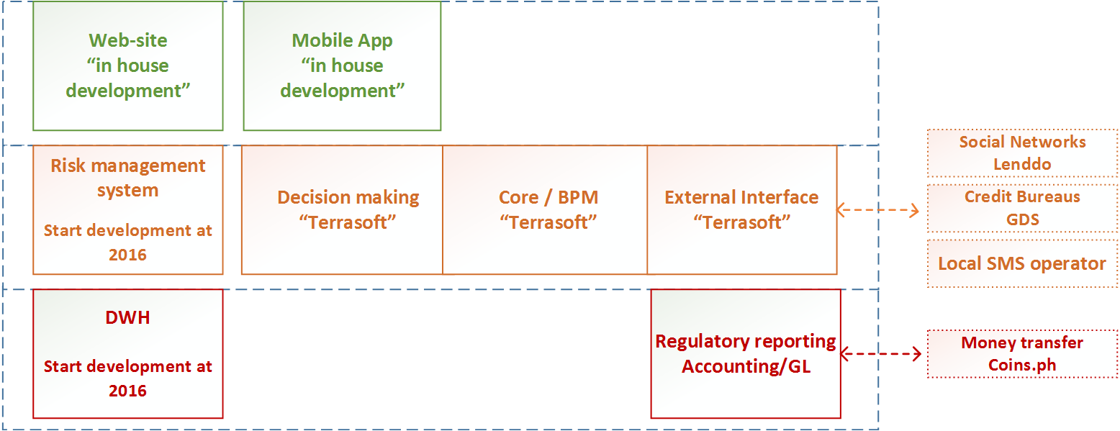
IT architecture

Slide 37
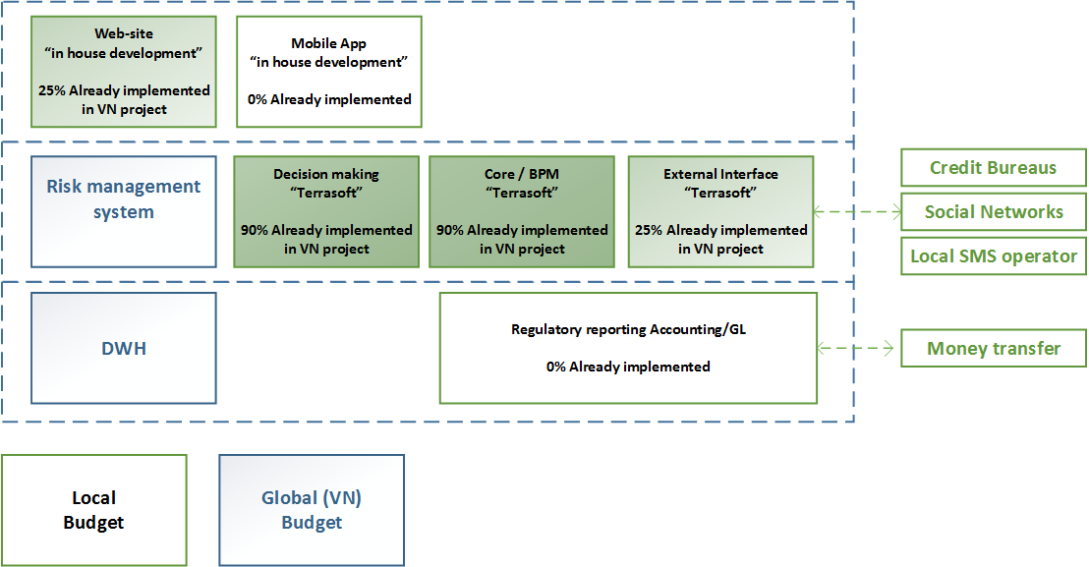
IT architecture- incremental view

Slide 38
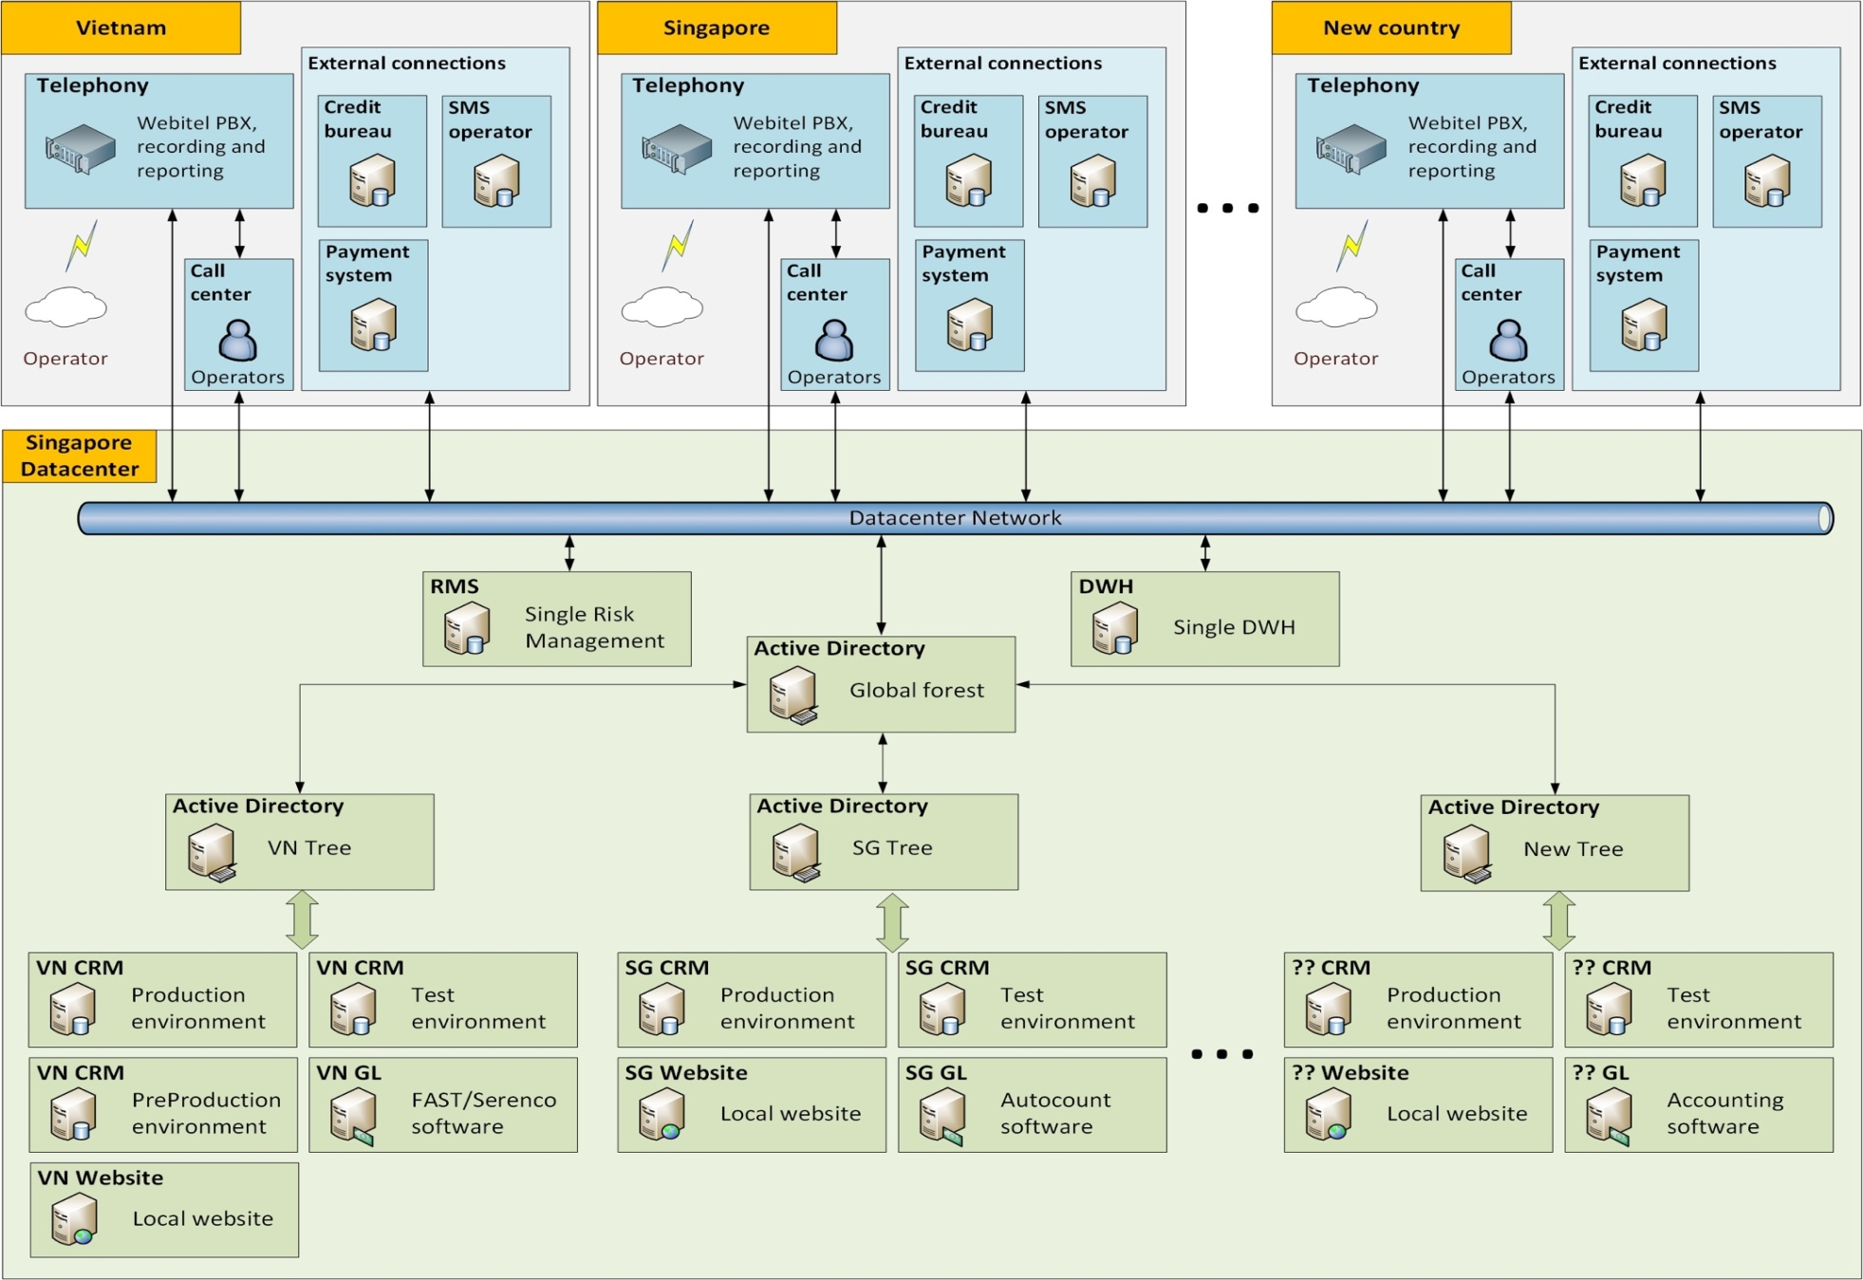
6. IT architecture geo layout
We will use standard geo layout, adopted to full online process.

Slide 39
6. IT scope of work
# | Integration partner | Type of the partner | Comments
1 | “PLDT” | SMS agent | Use biggest local provider
2 | “GDS Link” | Access to Credit bureau CIBI, BIP, Transunion | GDS allow to integrate with credit bureau before we will get license
3 | In-house decision for anti-fraud web –scoring | In-house | Allow to block ip –address from black lists
4 | “I am real” | Facebook verification and social scoring | Later will be replaced by in-house decision
5 | “QuickBooks” | Local GL system | Could be replaced with centralized system
6 | “DragonPay” | Local payment partner | Allow us to have one integration for cash-out
# | New functionality | The essence
1 | Customer notification | Integration with local sms agent for customer information
2 | Local GL system | Required for reporting to government agencies(BIR,SSS)
3 | Local Payment partner | DragonPay offer one integration to get wide cash out/in network
4 | Connection to PH Credit Bureau | Use GDS Link to get access to credit bureau before incorporation
5 | Risk partner I am real | Improvement credit process due to Facebook data
6 | Online antifraud | Let us to decrease fraud in online applications
We plan to accomplish preparing IT platform within 8 weeks starting from 23.11.2015

Slide 40
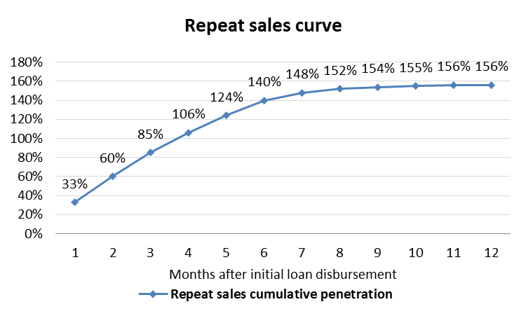
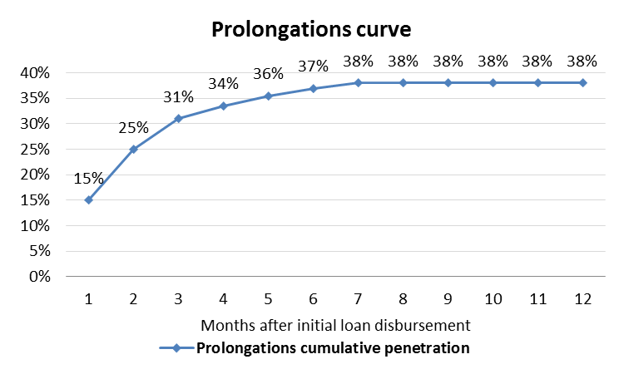
Financial model assumptions
Loan type | Avg term, days | Avg ticket, USD | Losses, %
New | 26 | 85 | 14.8%
Repeat | 26 | 125 | 11.3%
Prolongation new | 30 | 85 | 25.0%
Prolongation repeat | 30 | 125 | 25.0%
Product parameters | Value
Normal interest rate, per day | 1.00%
Late penalty interest rate, per day | 2.00%
Handling fee | 10%
Late payment fee, USD | 15
Year of project | 1 | 2 | 3 | 4 | 5
MAC, USD per loan | 48 | 10 | 10 | 10 | 10
Repeat sales per new loans | 156%
Prolongations per all loans | 38%

Slide 41
Investment summary
Investments, thsd USD | Year 1 | Year 2 | Year 3 | Year 4 | Year 5 | Total
Portfolio investments | 987 | 710 | 160 | 0 | 0 | 1 857
OPEX and CAPEX investments | 1 114 | 197 | 0 | 0 | 0 | 1 310
Total investments | 2 101 | 907 | 160 | 0 | 0 | 3 167
Volume indicators | Year 1 | Year 2 | Year 3 | Year 4 | Year 5 | Total
Number of loans issued, thsd | 30 | 173 | 351 | 520 | 620 | 1 694
Amount disbursed, thsd USD | 2 484 | 14 095 | 28 198 | 41 569 | 49 284 | 135 630
Net portfolio (EoY), thsd USD | 680 | 2 287 | 4 038 | 5 555 | 5 942 | 18 503
P&L, thsd USD | Year 1 | Year 2 | Year 3 | Year 4 | Year 5 | Total
Revenue | 958 | 6 573 | 14 074 | 21 442 | 26 094 | 69 140
Provisions | -600 | -3 003 | -5 517 | -7 373 | -8 793 | -25 287
Variable costs | -517 | -1 317 | -2 430 | -3 539 | -4 146 | -11 948
Marketing acquisition costs | -369 | -608 | -1 112 | -1 577 | -1 775 | -5 441
Salary (variable part) | -97 | -355 | -575 | -817 | -969 | -2 813
Other variable costs | -43 | -211 | -383 | -565 | -672 | -1 875
VAT | -8 | -143 | -360 | -579 | -729 | -1 820
Fixed costs | -1 033 | -1 193 | -1 235 | -1 450 | -1 543 | -6 454
Salary (fixed part) | -682 | -752 | -745 | -959 | -1 095 | -4 233
Other G&A expenses | -351 | -441 | -490 | -490 | -448 | -2 221
One-off expenses | -57 | -17 | -17 | -17 | -17 | -126
Net profit before taxes | -1 249 | 1 043 | 4 875 | 9 063 | 11 594 | 25 325
Terminal value |  |  |  |  |  | 55 122
ROE (annualized) |  |  |  |  |  | 120%
ROAA (yearly) | -184% | 70% | 116% | 142% | 151% | 130%
Break-even period – 12 months
Self-capitalization period – 19 months
Payback period – 39 months
Total investments – $3,1M
Unoptimized Yr5 corporate tax – $2,9M
Terminal Value – $55,1M (Gordon growth model with discount factor 15% and growth rate 0%)

Slide 42
Balance sheet
Balance Sheet (EOY)
thsd USD | Year 1 | Year 2 | Year 3 | Year 4 | Year 5
Assets | 852 | 2 682 | 4 678 | 6 406 | 6 833
Liquid assets | 102 | 343 | 606 | 833 | 891
Loans to individuals (net of provisions) | 680 | 2 287 | 4 038 | 5 555 | 5 942
Total loans | 1 280 | 5 891 | 13 158 | 22 049 | 31 229
Risk provisions | -600 | -3 603 | -9 120 | -16 494 | -25 287
Other receivables | 69 | 52 | 35 | 17 | 0
Shareholders' equity | 852 | 2 682 | 4 678 | 6 406 | 6 833
Contributed equity | 2 101 | 3 007 | 3 167 | 3 167 | 3 167
Retained earnings | -1 249 | -206 | 3 450 | 10 247 | 18 942
Dividends paid | 0 | -119 | -1 939 | -7 008 | -15 276
Equity+Liabilities | 852 | 2 682 | 4 678 | 6 406 | 6 833

Slide 43
P&L Statement
P&L
thsd USD | Year 1 | Year 2 | Year 3 | Year 4 | Year 5 | Total
Interest Income | 958 | 6 573 | 14 074 | 21 442 | 26 094 | 69 140
Primary sales | 467 | 2 463 | 4 788 | 7 004 | 8 121 | 22 843
Repeat Sales | 490 | 4 110 | 9 287 | 14 438 | 17 972 | 46 298
Risk provisions | -600 | -3 003 | -5 517 | -7 373 | -8 793 | -25 287
Primary sales | -348 | -1 300 | -2 139 | -2 737 | -3 108 | -9 632
Repeat Sales | -252 | -1 703 | -3 378 | -4 637 | -5 685 | -15 655
Variable costs* | -517 | -1 317 | -2 430 | -3 539 | -4 146 | -11 948
Marketing acquisition costs | -369 | -608 | -1 112 | -1 577 | -1 775 | -5 441
Salary (variable part) | -97 | -355 | -575 | -817 | -969 | -2 813
Other variable costs | -43 | -211 | -383 | -565 | -672 | -1 875
VAT | -8 | -143 | -360 | -579 | -729 | -1 820
Operating profit (before fixed costs) | -159 | 2 253 | 6 127 | 10 530 | 13 155 | 31 906
Fixed costs* | -1 033 | -1 193 | -1 235 | -1 450 | -1 543 | -6 454
Salary (fixed part) | -682 | -752 | -745 | -959 | -1 095 | -4 233
Other G&A expenses | -351 | -441 | -490 | -490 | -448 | -2 221
One-off expenses | -57 | -17 | -17 | -17 | -17 | -126
Profit before Taxes** | -1 249 | 1 043 | 4 875 | 9 063 | 11 594 | 25 325
* See slides 56-57 for details
** Estimated amount of profit tax for 5th year is $2,9M

Slide 44
Cash flow statement
Cash flow
thsd USD | Year 1 | Year 2 | Year 3 | Year 4 | Year 5 | Total
Loans issued | -2 484 | -14 095 | -28 198 | -41 569 | -49 284 | -135 630
Principals received | 1 471 | 11 051 | 24 064 | 37 296 | 45 581 | 119 462
Interest received | 691 | 5 007 | 10 941 | 16 823 | 20 617 | 54 079
Loan fees received | 0 | 0 | 0 | 0 | 0 | 0
Fines & penalties received | 0 | 0 | 0 | 0 | 0 | 0
Total CF from business activities: | -323 | 1 963 | 6 807 | 12 551 | 16 914 | 37 912
Commissions to agents & payment systems | -8 | -54 | -114 | -173 | -208 | -558
POS costs | 0 | 0 | 0 | 0 | 0 | 0
People costs | -769 | -1 050 | -1 203 | -1 600 | -1 850 | -6 472
Marketing & Acquisition costs | -378 | -665 | -1 230 | -1 753 | -1 989 | -6 015
Support costs | -18 | -65 | -103 | -150 | -165 | -501
Office costs | -186 | -355 | -478 | -554 | -569 | -2 142
IT costs | -154 | -70 | -70 | -70 | -70 | -434
Professional services | -40 | 0 | 0 | 0 | 0 | -40
Other income (expenses) | -115 | -108 | -108 | -108 | -108 | -547
Profit tax | 0 | 0 | -1 219 | -2 266 | -2 899 | -6 383
VAT paid | -8 | -143 | -360 | -579 | -729 | -1 820
Working Capital required | 0 | 0 | 0 | 0 | 0 | 0
Total CF from operating expenses: | -1 676 | -2 510 | -4 884 | -7 254 | -8 587 | -24 911
Total CF from operating activities: | -1 999 | -547 | 1 923 | 5 297 | 8 326 | 13 000
Financing received | 2 101 | 907 | 160 | 0 | 0 | 3 167
Financing returned | 0 | -119 | -1 820 | -5 069 | -8 268 | -15 276
Interest expense | 0 | 0 | 0 | 0 | 0 | 0
Total CF from financing activities: | 2 101 | 788 | -1 660 | -5 069 | -8 268 | -12 109
CAPEX | 0 | 0 | 0 | 0 | 0 | 0
Total CF for the period: | 102 | 241 | 263 | 228 | 58 | 891
Cash balance beginning: | 0 | 102 | 343 | 606 | 833 | 833
Cash balance ending: | 102 | 343 | 606 | 833 | 891 | 891

Slide 45
Expenses detailed
Variable costs, thsd. USD
Expenses category | Year 1 | Year 2 | Year 3 | Year 4 | Year 5 | Total
Marketing acquisition costs | -369 | -608 | -1 112 | -1 577 | -1 775 | -5 441
Salary (variable part) | -97 | -355 | -575 | -817 | -969 | -2 813
Other variable costs | -43 | -211 | -383 | -565 | -672 | -1 875
Telecommunications - acquisition | -11 | -43 | -74 | -108 | -127 | -362
Outbound SMS - acquisition | -6 | -32 | -64 | -94 | -110 | -307
Payment system fees | -8 | -54 | -114 | -173 | -208 | -558
Telecommunications - support | -15 | -67 | -102 | -147 | -175 | -506
Outbound SMS - support | -3 | -15 | -30 | -43 | -52 | -142
VAT | -8 | -143 | -360 | -579 | -729 | -1 820
Total | -517 | -1 317 | -2 430 | -3 539 | -4 146 | -11 948
Fixed costs, thsd. USD
Expenses category | Year 1 | Year 2 | Year 3 | Year 4 | Year 5 | Total
Salary (fixed part) | -682 | -752 | -745 | -959 | -1 095 | -4 233
Salary | -462 | -481 | -481 | -481 | -481 | -2 384
Bonuses | -220 | -272 | -265 | -479 | -614 | -1 850
Other G&A expenses | -351 | -441 | -490 | -490 | -448 | -2 221
Rent/office expenses | -124 | -209 | -266 | -264 | -231 | -1 094
IT expenses | -113 | -124 | -115 | -119 | -109 | -580
Miscellaneous | -115 | -108 | -108 | -108 | -108 | -547
Total | -1 033 | -1 193 | -1 235 | -1 450 | -1 543 | -6 454

Slide 46
One-off expenses
Expenses category | Total, thsd USD
HR expenses | -40
Recruiting | -40
IT expenses | -86
СRM development | -56
Collection system implementation | -19
Web sites | -7
Mobile sites&app | -4
Total | -126

Slide 47
8. Main identified risks and their mitigation 1/2
# | Risk type | Risk | Mitigation tool
1 | Target license | It will take longer than our expectation time to get license from SEC | Accelerating SyCip lawyers Cooperating with local lobbyist with connections in SEC
2 | Licensing | Regulator will reject nominal president or director | Change directors
3 | Target business model | Negative legal opinion on remote contract signing process | Uploading sign contract via site Hiring in-house lawyer and developing with SEC target business model of signing contract
 |  | Negative legal opinion on legitimacy of KYC and AML procedure, which we are going to do in money pick up points (our partners) | Hiring in-house lawyer and developing with SEC target business model of KYC in remote partners pick up points Sign contract with each partner, for KYC outsourcing
 |  | Non-achievement target volumes due to advertising channels limits | Developing alternative sales channels: application, partnership, ATL
4 | Operational | Invalid and/or incorrect personal data in online application (on web site or in CRM) | Built-in auto online checks Obligatory mobile number SMS-verification procedure
 |  | Loose customers application data | Saving all signature in CRM and everyday back up.
 |  | Technical bugs during process | Every week testing process with staff and IT
Notes:
При низком показателе проникновения кредитных продуктов, основная их часть сосредоточена в сегменте SEC A и SEC B, при высоких требованиях к заемщику. Стратегия DCFC – всегда доступная финансовая поддержка рядом с клиентом посзволяет ориентироваться на 70% рынка.

Slide 48
8.Main identified risks and their mitigation 2/2
# | Risk type | Risk | Mitigation tool
5 | Fraudulent | Fake ID using for application | Mandatory requirement of the second document in addition to ID Using CICI bureau to match id with black and white lists Using Phone verification to identify person Using Lenddo to identify person in Facebook
 |  | Using robots for mass application fulfilling | Obligatory mobile number SMS-verification Using Facebook verification Developing mobile app for better verification and scoring
 |  | Fraudsters attack | Automated black lists check (lists are both internal and external) and Phone verification Low initial loan amount (to minimize losses) Taking into consideration place of signing contract and desirable way of money transfer (will be taken into consideration by automatic scoring) Analyzing IP address and cookies during web application(to identify and reduce high risk)
 |  | Customers will apply for 2nd loan to close 1st loan | Frozen possibility to apply 2nd loan during first loan existing
 |  | Telemarketing and verification staff will be in cahoots with borrowers | New employees’ obligatory check for criminal records Analyzing performance of each person Cross-check and randomizing areas (districts of country) which staff cover in operations
6 | Collections | Customers unavailability in case of delinquency | Mandatory request of providing contact person’s mobile number in application in case of collections necessity Providing work and home phone numbers Application with gps tracking setting up to customer’s phone
 |  | Denying loan receipt in case of not repaying | Sending a copy of documents to customer.
 |  | Low responsibly for loan repayment fail | Getting check from customer(after check payment fail we can put customer to prison)
Notes:
При низком показателе проникновения кредитных продуктов, основная их часть сосредоточена в сегменте SEC A и SEC B, при высоких требованиях к заемщику. Стратегия DCFC – всегда доступная финансовая поддержка рядом с клиентом посзволяет ориентироваться на 70% рынка.

Slide 49

9. Project plan
Activity | Planning end date | Comments
Hiring CEO |  | HR agencies started searching process.
Licensing |  | Documents filed to SEC
Renting office |  | Signing contract
Creating team |  | We have regular candidates screening
IT settings, product settings |  | We identified all key partners
Official documents |  | Documentation preparation for customers and regulator
Start sales |  | We plan to start sales at the end of November- beginning December.
Activity
Hiring CEO
Licensing
Renting office
Creating team
IT settings, product settings
Legal Setup for our business process
Start operations
We are planning to launch operations at the XXXXXXXXX 201.

Slide 50
9. Next steps
Activity | Sub activity | Planed date
Hiring CEO | Obtaining short list of candidates | 30-Oct-15
 | Final interview | 11 -Nov-15
 | Contract sign | 15-Nov-15
Licensing | Filling all documents for SEC | 30-Sep-15
 | Bank Account opening and pre-paid capital transferring | 18-Sep-15
 | Application to SEC | 30-Sep-15
Renting office | Negotiation Lessor | 14-Sep-15
 | Signing Contract | 18-Sep-15
Creating team | Obtaining short list of candidates for Legal, Accounting, Risk and IT | 01-Nov-15
IT settings, product settings | List of partners creation | 04-Sep-15
 | Technical task preparation | 11-Oсt-15
 | Contracts sign with partners | 10-Nov-15
 | Development | 23-Nov-15
Legal Setup for our business process | Structure approval by lawyers | 17-Sep-15
 | Development of internal documentation | 3-Nov-15
 | Development of documentation for SEC | 3-Nov-15
The most difficult and time-consuming process is the acquisition of license

Slide 51
Regulatory Environment
Requirement | Act | Section / Article | Implementing Agency | Comment
Confidentiality & Use of Credit Information | R.A. No. 9510 | Section 6 | SEC | The Corporation, the submitting entities, the accessing entities, the special accessing entities and the duly authorized non-accessing entities shall hold the credit information under strict confidentiality and shall use the same only for the declared purpose of establishing the creditworthiness of the borrower.
KYC | R.A. No. 9160 | Section 9 | Anti-Money Laundering Council | Covered institutions shall establish and record the true identity of its clients based on official documents.
Data Privacy | R.A. No. 10173 | Entire Act | (DICT) | Processing of personal or sensitive, personal information requires the consent of the data subject. The data must be used only for authorized purposes, retained, and disposed of properly.
Electronic Documents | R.A. No. 8792 | Section 6 & 7 | DTI | Information shall not be denied legal effect, validity or enforceability solely on the grounds that it is in the data message purporting to give rise to such legal effect, or that it is merely referred to in that electronic data message.
Electronic Signatures | R.A. No. 8792 | Section 8 & 9 | DTI | An electronic signature on the electronic document shall be equivalent to the signature of a person on a written document if that signature is proved by showing that a prescribed procedure, not alterable by the parties interested in the electronic document, existed...
Usury | R.A. No. 386 | Article 1413 & 1957 | NA | Interest paid in excess of the interest allowed by the usury laws may be recovered by the debtor, with interest thereon from the date of the payment. Contracts and stipulations, under any cloak or device whatever, intended to circumvent the laws against usury shall be void. The borrower may recover in accordance with the laws on usury.

Slide 52
Main regulations of company management
Requirements | Act | Comment | Primary document for SEC
Financing company (‘Company”) | R.A. No. 8556 | “Stock corporations at least forty percent (40%) of the voting stock of which is owned by citizens of the Philippines. Shall have a paid-up capital of not less than Ten million pesos (P10,000,000) in case the financing company is located in Metro Manila”.
Company shareholders | R.A. No. 8556 Sections 6 and 16, Corporation Code | XXXXXXXXXXXXXX PTE LTD (Singapore) – 60%, Philippino citizen – 40% | Articles of Incorporation By-Laws
Company shareholders Rights and Restrictions | Articles III, IV of the By-laws | Article III Restrictive covenants – non-compete, non-solicitation Article IV Reserved matters that require either 2/3 of shareholders’ approval as per local laws (amendment of the By-laws, denial of pre-emptive right, distribution of dividends, any M&A deal, etc) or majority approval (any material change in the nature of the business, formation of subsidiaries, granting or taking any loan in the excess of 50 000 USD, etc) | By-Laws
General Meetings of Shareholders (GMS) | Article II | 1. on last Friday of June of each year 2. Special meetings with 2 weeks notice from directors or majority shareholder | By-Laws
Special Restriction on Local Shareholder |  | 1. Call-Option enables XXXXXXXXXXXXXX or its designee to buy shares of local shareholder at a nominal price 2. Call - Option could be realized on demand of XXXXXXXXXXXXX | Call-option
The Board of Directors | Article VI of By-laws, Corporation Code | The Board shall be composed of five directors, who are elected by the shareholders. The Corporation shall have 2 independent directors, 2 representing majority shareholder and 1 representing local shareholder | Articles of Incorporation By-Laws
The Board of Directors Rights and Restrictions | Article IV of By-Laws | 1. The Board of Directors supports the execution of business plan and company operations 2. The Board should observe the reserved matters that are for shareholders to decide on 3. No decision can be approved if number of directors who voted was less then 4 overall or 2 directors from XXXXXXXXXXXXX were absent | By-Laws
Election of The Board of Directors |  | Board of Directors should be elected during GMS and hold office for one year In case of any vacancy it should be filled after approval of XXXXXXXXXXXXX | By-Laws
Access to Bank Account |  | Only the Country Manager has access to the bank account of the Company

Slide 53
Offline Anti fraud procedures
# | Concentrations | Short description | Systems
0 | By customer IP | Block all applications from computer with high level of fraud | In-house system, Own statistic
1 | By addresses, places, district, GPS coordinates | Block all applications from place with high level of fraud | CB, Own statistic
2 | By contacts | Block all applications with contacts with high level of fraud | CB, Own statistic
3 | By Facebook friends | Block all applications if friend with high level of fraud | I am Real
4 | By money transfer way/ bank/ payment system | Block all applications I payment system with high level of fraud | In-house system, Own statistic
Calculate concentrations every week and block fraud areas

